Slide 1

Support for Windows 7
Chapter 2
Securing and Troubleshooting Windows 7

Slide 2
Chapter Objectives
In this chapter, you will learn
  About Windows utilities and tools you can use that support Windows 7
  How to secure Windows 7 and the resources it shares on a network
  How to solve problems with Windows 7 startup

Slide 3
Windows 7 Utilities and Tools to Support the OS
Windows 7 utilities and tools used to support the OS are similar or the same as those used in Windows Vista
Table 2-1 on pages 74 – 79
Windows Vista Software Explorer is not included in Windows 7
Use the System Configuration Utility (Msconfig) instead when you want to control the processes that launch at startup

Slide 4
Windows 7 Utilities and Tools to Support the OS (cont’d.)
Windows 7 uses the same command prompt utilities as does Vista
Command prompt utilities:
  Telnet:
    A Windows command-line client/server application
    Allows an administrator or other user to control a computer remotely
  Ping: a command used to troubleshoot network connections by verifying that the host can communicate with another host on the network

Slide 5
Windows 7 Utilities and Tools to Support the OS (cont’d.)
Command prompt utilities:
  Ipconfig: displays the IP address of the host and other configuration information
  Dxdiag: displays information about hardware and diagnoses problems with DirectX.
  Cmd: launches a command prompt window.
  Xcopy: used to copy files and folders and has many options to control how the copy operation will proceed
  Net: collection of commands used to display information about network connections, make connections, and solve problems

Slide 6
Windows 7 Utilities and Tools to Support the OS (cont’d.)
  Tracert: Traces the route from the host to a destination host and displays each hop to the destination
  Netstat: displays statistics about network activity. It can be used to identify a program hogging network resources
  Nslookup: reads and displays information from the Internet name space used to resolve domain names and their corresponding IP addresses kept by a DNS server

Slide 7
Windows 7 Utilities and Tools to Support the OS (cont’d.)
Startup folders are the same as they are in Windows Vista
  For individual users: C:\Users\username\AppData\Roaming\Microsoft\Windows\Start Menu\Programs\Startup
  For all users: C:\ProgramData\Microsoft\Windows\Start Menu\Programs\Startup

Slide 8
Windows 7 Utilities and Tools to Support the OS (cont’d.)
Windows 7 is:
  Engineered to make fewer reads and writes to the hard drive to improve performance
  Designed to perform better when using solid state drives (SSDs)
For USB flash drives
  Consider using the exFAT file system
  exFAT file system
    Also called the FAT64 file system
    Structured the same as the older FAT32 file system

Slide 9
Windows 7 Utilities and Tools to Support the OS (cont’d.)
When you format an internal drive using Disk Management, the partitioning and formatting wizard offers the option to use the exFAT or the NTFS file system
Use NTFS for very large hard drives or drives that will contain the Windows installation

Slide 10
Securing Windows 7 Resources
In a small office, home office, or small business
  Networks are most likely set up as a peer-to-peer network rather than a domain
  Security on a domain is controlled by a domain controller
  Security for each PC is maintained at the local level by Windows installed on each PC
To control access to resources on the computer:
  User accounts
  Permissions

Slide 11
Securing Windows 7 Resources (cont’d.)
To control access to resources on the network:
  Homegroup security
  Workgroup security with user accounts and passwords
  Shared permissions
  User Account Control (UAC) box
  Windows Firewall
  Antivirus and antispyware software
  Hardware firewall
  Advanced encryption technologies
  Scheduled backups and user training

Slide 12
Securing Windows 7 Resources (cont’d.)
Two approaches to sharing resources on a small peer-to-peer network:
  A Windows 7 homegroup
  A workgroup with user accounts and passwords
A homegroup is an easy way to share resources on a network of Windows 7 computers when strict measures are not required

Slide 13
Securing Windows 7 Resources (cont’d.)
Windows determines if a homegroup exists on the network and if the computer has already joined it
Depending on the situation, three things can happen
  A homegroup exists and the computer has not yet joined the homegroup
  A homegroup has not yet been set up on the network
  The computer has already joined a homegroup

Slide 14
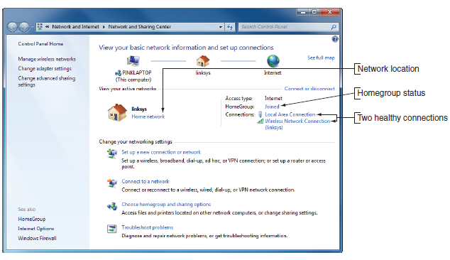
Figure 2-1 Network and Sharing Center
Courtesy: Course Technology/Cengage Learning

Slide 15
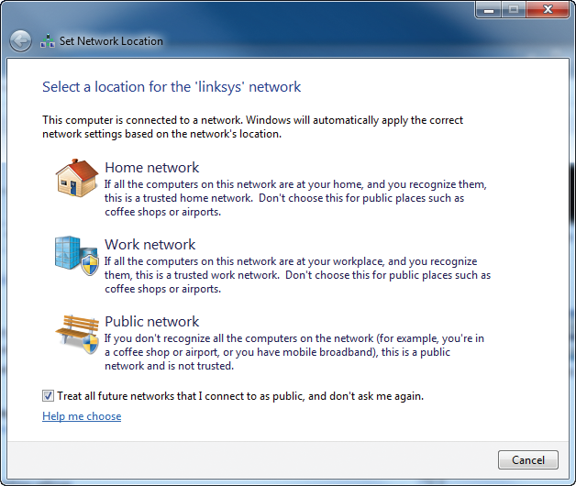
Figure 2-2 Set the network location
Courtesy: Course Technology/Cengage Learning

Slide 16
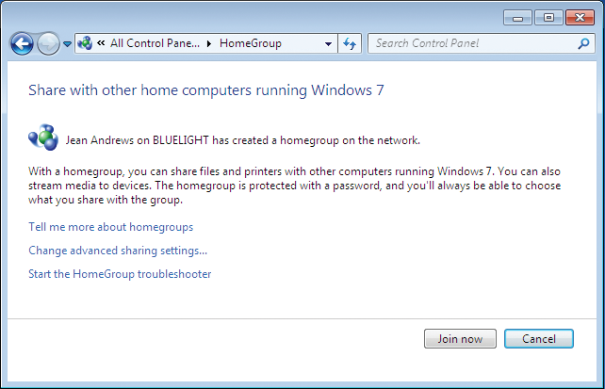
Figure 2-3 The computer does not belong to a homegroup
Courtesy: Course Technology/Cengage Learning

Slide 17
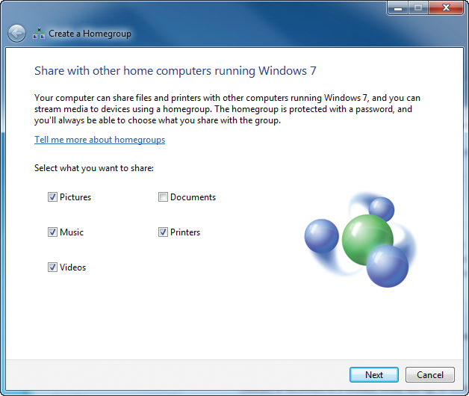
Figure 2-6 Create a homegroup
Courtesy: Course Technology/Cengage Learning

Slide 18
Securing Windows 7 Resources (cont’d.)
Windows Firewall in Windows 7 functions about the same way as it does in Vista
The windows in Windows Firewall are organized differently

Slide 19
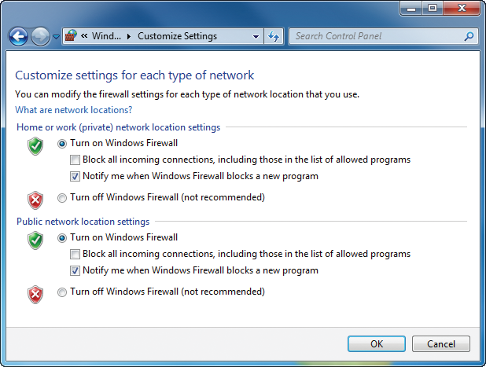
Figure 2-14 Customize settings for a private or public network
Courtesy: Course Technology/Cengage Learning

Slide 20
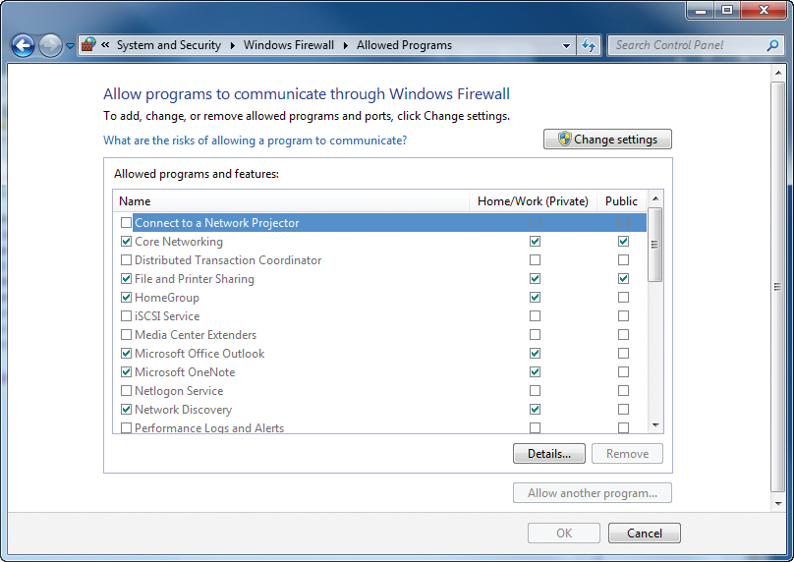
Figure 2-15 Allow programs to communicate through the firewall
Courtesy: Course Technology/Cengage Learning

Slide 21
Solving Windows 7 Startup Problems
Windows 7 and Vista use
  The same startup files and processes
  The same two main tools for solving problems with startup processes
    The Advanced Boot Options menu
    The Windows Recovery Environment (Windows RE)
Windows Recovery Environment (Windows RE) is
  Installed on the hard drive by default in Windows 7
  Available to you from the Advanced Boot Options menu

Slide 22
Solving Windows 7 Startup Problems (cont’d.)
Windows RE
  Is a lean operating system
  Can be launched to solve Windows startup problems after other tools available on the Advanced Boot Options menu have failed
In Windows 7, Windows RE is installed on the hard drive and available on the Advanced Boot Options menu

Slide 23
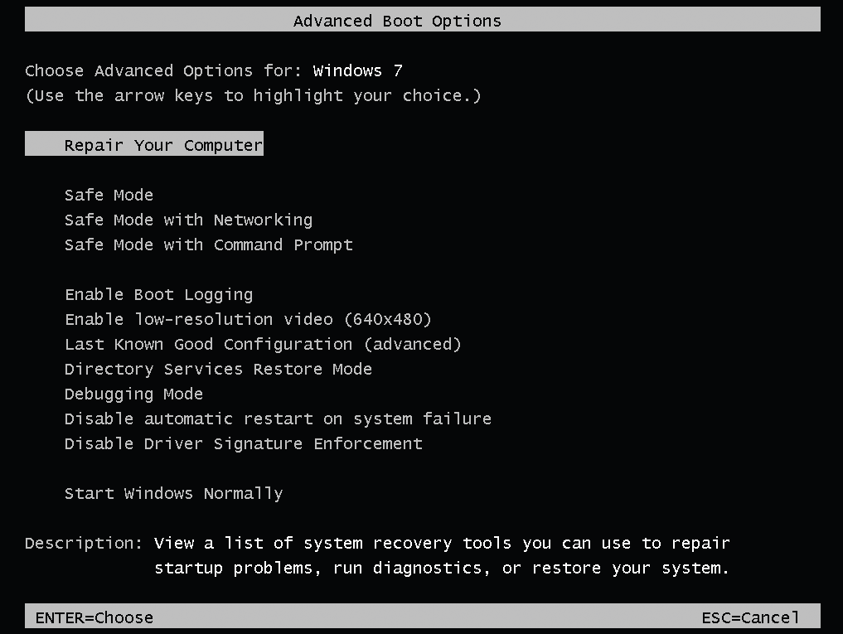
Figure 2-16 Press F8 during the boot to launch the Windows 7 Advanced Boot Options menu
Courtesy: Course Technology/Cengage Learning

Slide 24
Solving Windows 7 Startup Problems (cont’d.)
When deciding which recovery tool to use, always use the least intrusive tool first
Fix the problem while making as few changes to the system as possible

Slide 25
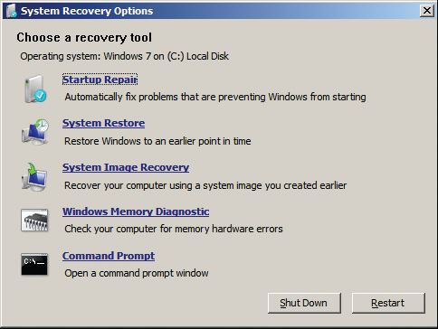
Figure 2-19 Recovery tools in Windows RE
Courtesy: Course Technology/Cengage Learning

Slide 26
Solving Windows 7 Startup Problems (cont’d.)
System repair disk
  Used to launch Windows RWE
  Can be created during some installations of Windows 7 and any time after installation
  Can be useful if Windows 7 will not start, you cannot launch Windows RE from the hard drive, and you do not have a Windows 7 setup DVD to launch Windows RE
  A 32-bit installation creates a 32-bit version of the repair disc
  A 64-bit installation creates a 64-bit version

Slide 27
Summary
Many commands and tools from Windows Vista work the same as they did in Windows 7
The exFAT filesystem is recommended for removable drives and NTFS is recommended for all fixed storage devices
The Action Center is more powerful than the Security Center
Backup and Restore is more fine grained in Windows 7
A system image is equal to a Complete PC Backup in Vista

Slide 28
Summary (cont’d.)
Performance Monitor and Resource Monitor are now two separate tools
Administrative control over UAC is much more tunable than in Vista
System Configuration Utility replaces Software Explorer
Firewall is functionally equivalent to Vista but organized differently
Addition of Windows Security essential antivirus, to complement Windows Defender antispyware

Slide 29
Summary (cont’d.)
Boot options remain the same as Vista with Windows Recovery Environment (RE) added as a new option.
Multiple methods of starting Windows RE, including original installation media.
Windows repair disc (a method of launching Windows RE) created from Backup and Restore utility.
Repair disc can be used for any edition as long as the version (32-bit or 64-bit) is the same.

